Slide 1








JSS academy of technical education Bangalore
Artificial Intelligence and Machine Learning
Title Crop Production Prediction FIFA World Cup Analysis IBM HR Analytics: Employee Attrition & Performance Heart Disease Diagnostic Analysis
Guide
Ms. Sneha Y S
Dept of AIML
JSSATEB
Deeksha S S
1JS21AI012

Slide 2



CONTENTS
ABSTRACT
INTRODUCTION
METHODOLOGY
RESULTS
CONCLUSION
REFERENCES

Slide 3




ABSTRACT
This series of projects applies data analytics to healthcare, agriculture, sports, and human resources to uncover valuable insights. The Heart Disease Diagnostic Analysis focuses on identifying risk factors for heart disease using clinical data. The Crop Production Prediction project aims to forecast crop yields based on historical agricultural data. The FIFA World Cup Analysis examines tournament data to determine key performance metrics influencing match outcomes. Finally, the IBM HR Analytics project explores factors affecting employee attrition and performance. All projects utilize data preprocessing, exploratory analysis, and interactive dashboards to facilitate informed decision-making.

Slide 4



INTRODUCTION
INTRODUCTION
This collection of projects explores the application of data analytics and visualization across four key domains—agriculture, sports, human resources, and healthcare—each addressing unique challenges. The Crop Production Prediction project leverages historical agricultural data to forecast yields and analyze key metrics, supporting better planning and resource allocation. In sports, the FIFA World Cup Analysis uncovers patterns and performance metrics influencing tournament outcomes, offering valuable insights into football strategies and trends. The IBM HR Analytics project delves into employee data to understand the factors driving attrition and performance, helping organizations optimize their workforce. Lastly, in healthcare, the Heart Disease Diagnostic Analysis focuses on identifying critical risk factors using clinical data to aid in early detection and prevention. These projects demonstrate the transformative potential of data-driven insights in solving real-world problems across diverse sectors.

Slide 5

METHODOLOGY
Data Loading : Used pandas to load the dataset with error handling for missing or invalid files.
Data Cleaning : Removed rows with missing values in the Production column to ensure data accuracy.
Visualizations Tree map : Displays production by state and season using the squarify library.
Geographical Map : Shows crop production by state with plotly.express choropleth.
Bar Chart : Highlights total production for each season using seaborn.
Pie Chart : Depicts area distribution across seasons using matplotlib.
Histogram: Analyzes production distribution with frequency bins.
Execution Functions modularized for tasks : data loading, cleaning, and creating each visualization.
Outcome : Provides insights into crop production trends and geographical patterns.
Tableau : can help anyone see and understand their data. Connect to almost any database, drag and drop to create visualizations, and share with a click.

Slide 6

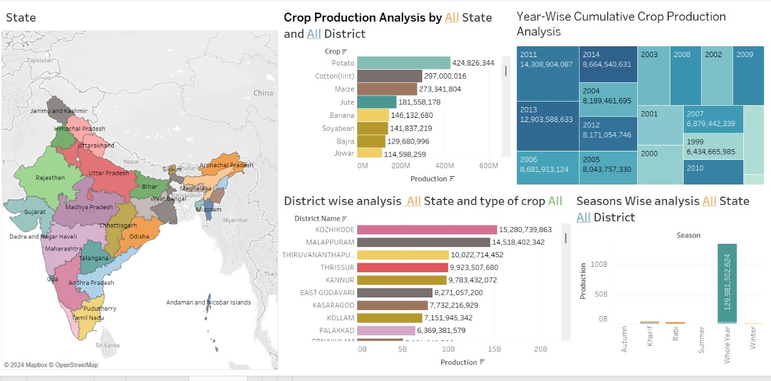
Crop Production Prediction

Slide 7
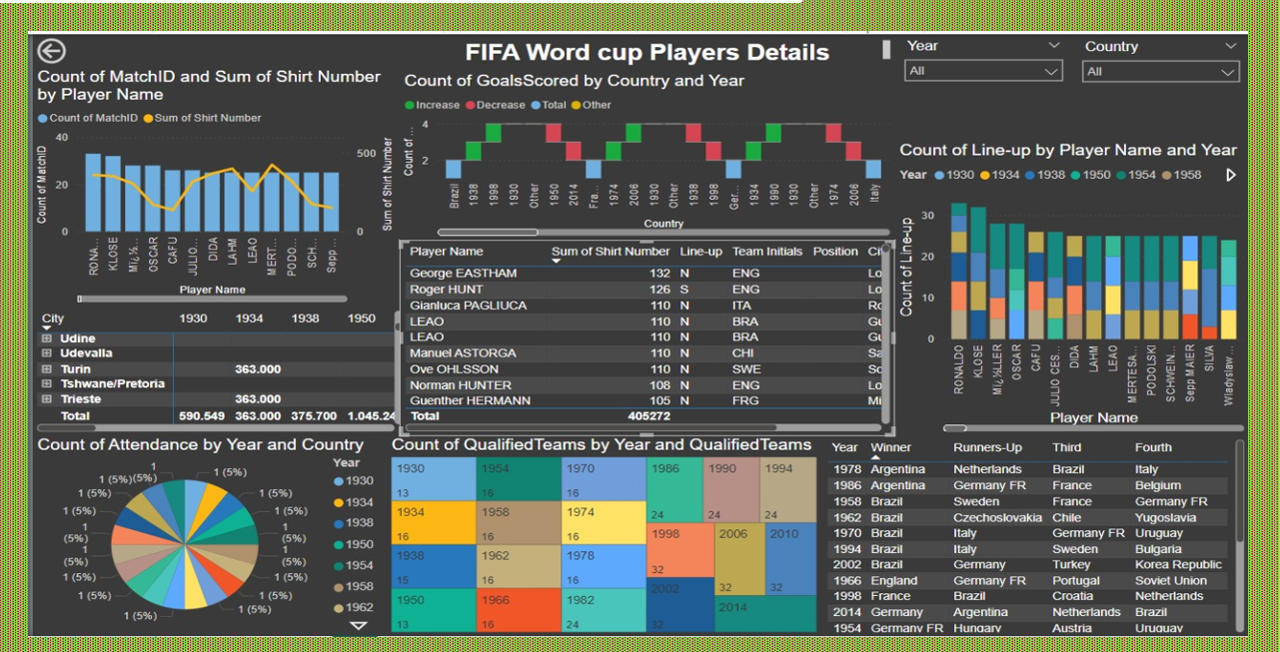

Slide 8
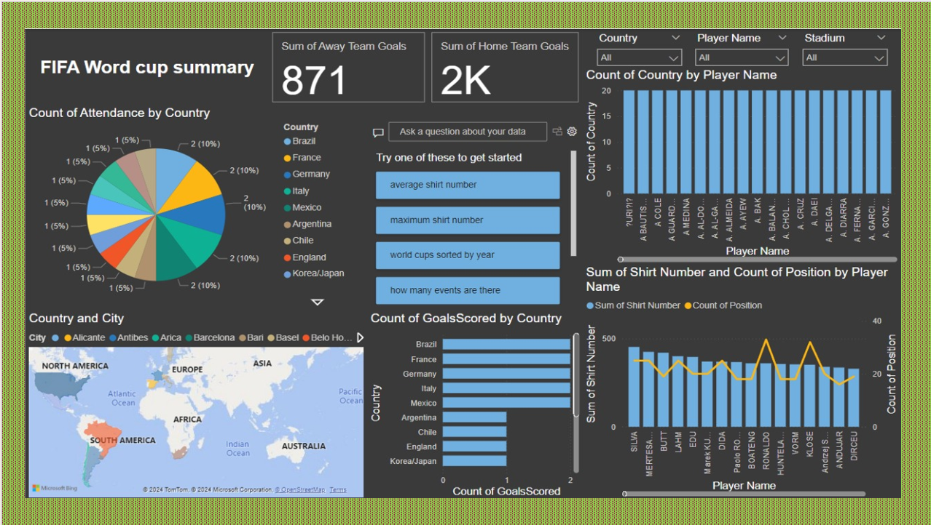

Slide 9
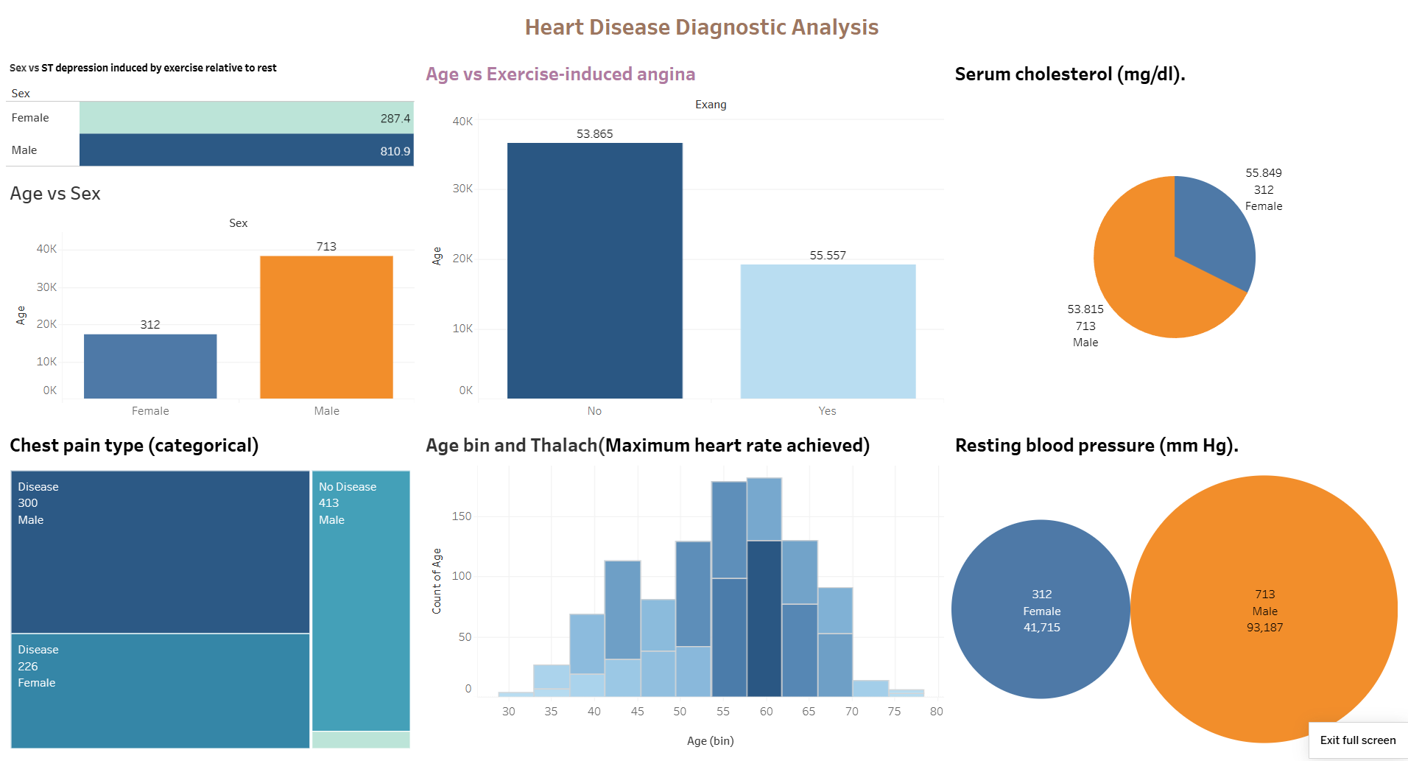

Slide 10
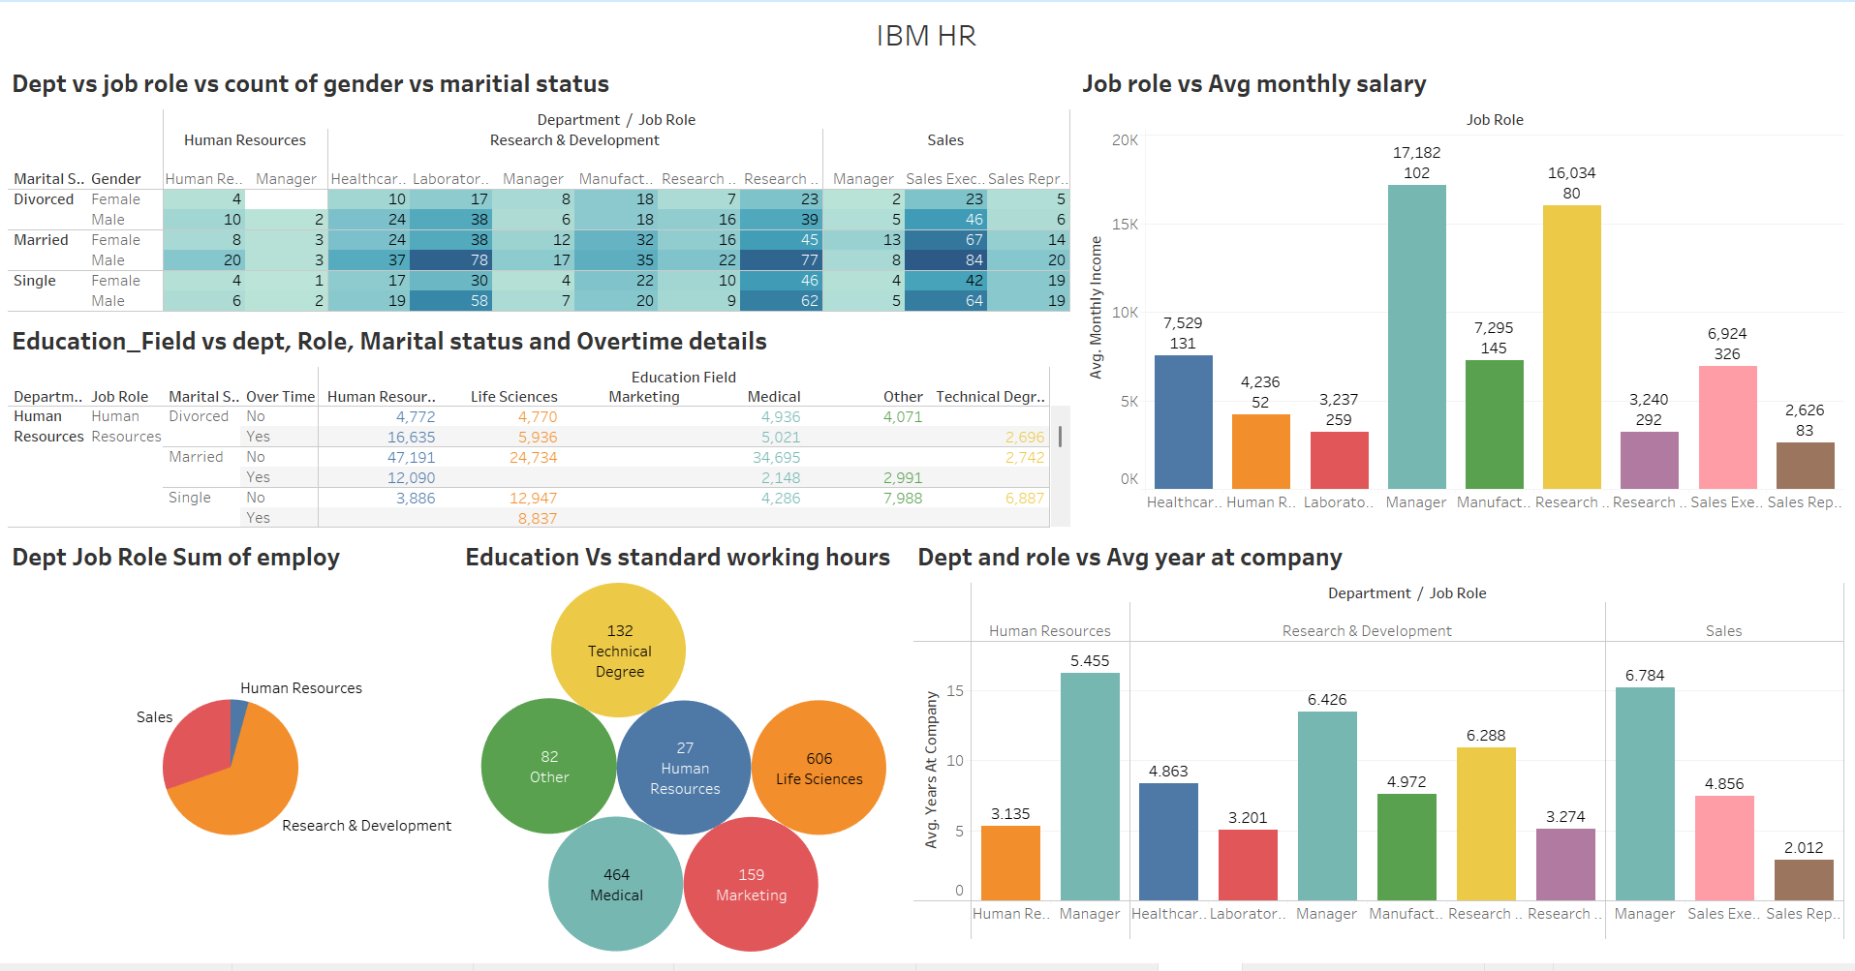

Slide 11
CONCLUSION
This series of projects demonstrates the power of data analytics in addressing challenges across agriculture, sports, human resources, and healthcare. The Crop Production Prediction project provided insights into factors affecting crop yields for better planning, while the FIFA World Cup Analysis identified performance metrics influencing tournament outcomes. The IBM HR Analytics project explored key drivers of employee attrition and performance, and the Heart Disease Diagnostic Analysis highlighted critical risk factors, aiding in early detection and prevention of heart disease.

Slide 12

REFERENCES
Datasets: Unified Mentor, Crop Production Analysis in India Data, https://drive.google.com/file/d/1b3E1vpDSYpHe8YlNs3jkt30Lx6acf0Uo/view
Python Libraries: Pandas: Wes McKinney, Python for Data Analysis, O'Reilly, 2017.Matplotlib: John D. Hunter,
Matplotlib: A 2D Graphics Environment, 2007.
NumPy: Charles R. Harris, et al., Array programming with NumPy, Nature, 2020.Visualization
Tools: Tableau Public, https://public.tableau.com.
Mentorship: Unified Mentor, Comprehensive Learning Resources, https://www.unifiedmentor.com.

Slide 13
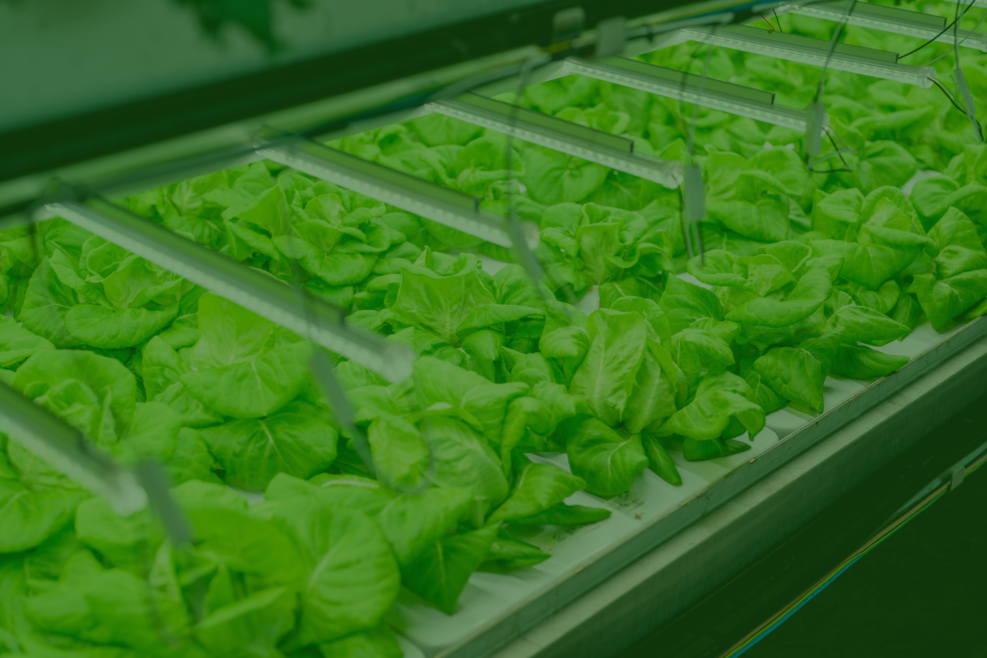

THANK YOU

